Slide 1






FreeCAD Basic Setup Tutorial
Written by Stefan van der Walt
04/04/2016

Slide 2
Introduction
Background:
This tutorial assumes no prior experience to the FreeCAD modeling environment.
Objectives:
Extract the FreeCAD folder to a chosen directory
Locating the executable file
Changing the preferences
Add environmental variable for multi-threaded solver

Slide 3
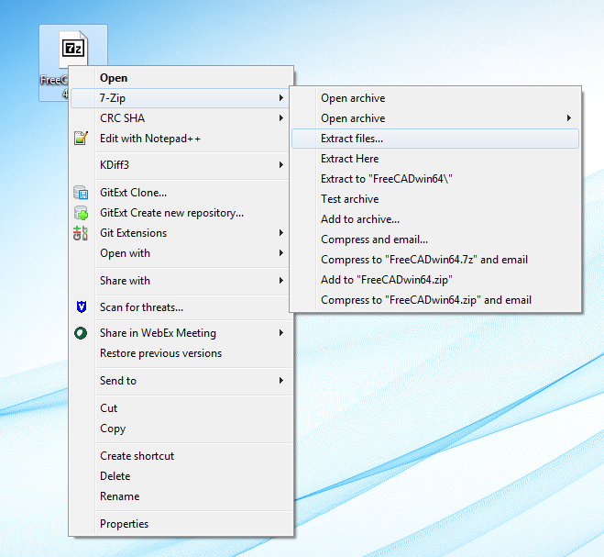
Extracting the zipped file
Extracting the zipped file:
After installing the program “7zip”, you can extract the “FreeCADwin64.7z” file by right-clicking on it and selecting the appropriate option from the 7-Zip submenu.
By selecting the option “Extract files…”, you can select the directory to which it will extract.
By selecting the “Extract Here” option, it will extract at the same location as the 7zip-file.
Extract to the location of your choice.

Slide 4
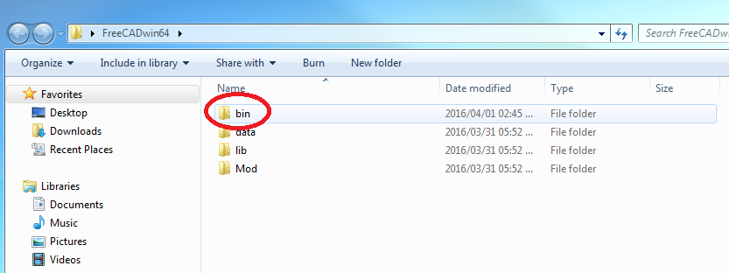
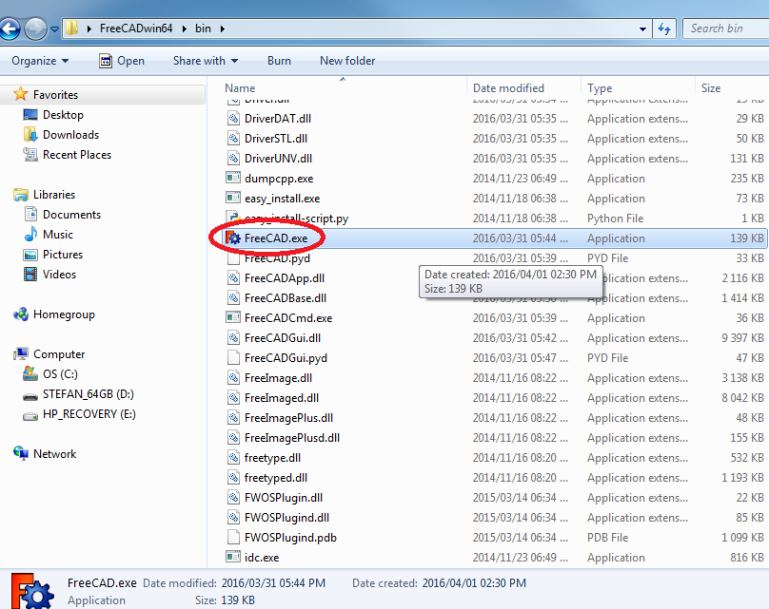
Locating the Executable File
Locating the executable file:
Once the file is extracted to the location of your choice, navigate to that location. You will see a folder named “FreeCADwin64” (or the name that you chose to give it). Open it.
Inside the folder you will see four folders. Open the folder named “bin”, this is the folder where all the binary files are located.
Once opened, scroll down until you see the “FreeCAD.exe” file. This is called an executable file, and is used to open FreeCAD.
You can either double-click on this file to open FreeCAD, or you can create a shortcut and place it anywhere you want for easier access to FreeCAD. This step is explained on the next slide.

Slide 5
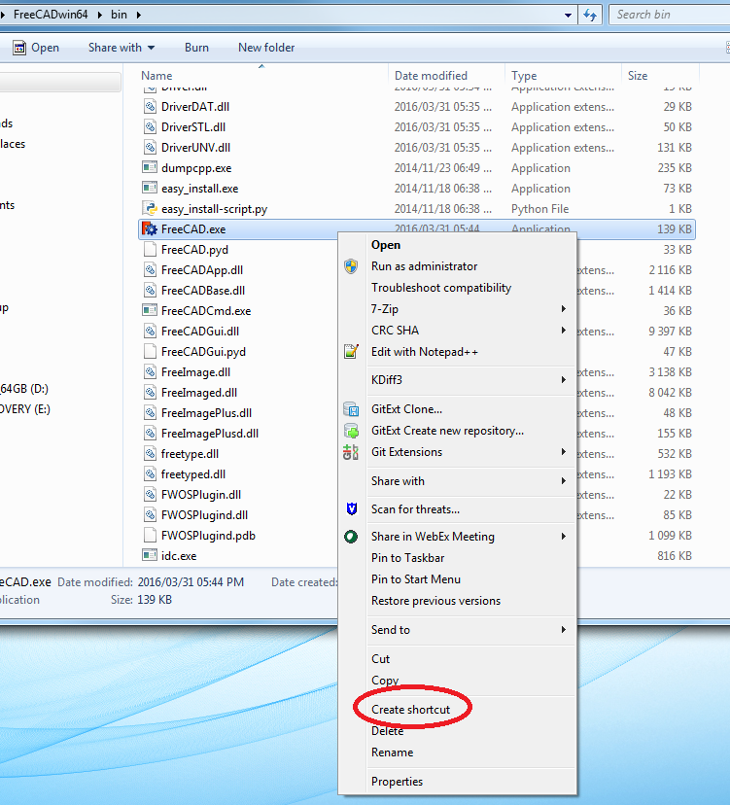
Creating a Shortcut to the Executable File
Creating the shortcut:
If you decide to create a shortcut for easier access, right-click on the “FreeCAD.exe” file and select “Create Shortcut”. This will create a shortcut directly underneath the “FreeCAD.exe” file, called “FreeCAD.exe - Shortcut”.
Move this shortcut file to the desired location (i.e. the Desktop, the taskbar etc.) for easier access.

Slide 6
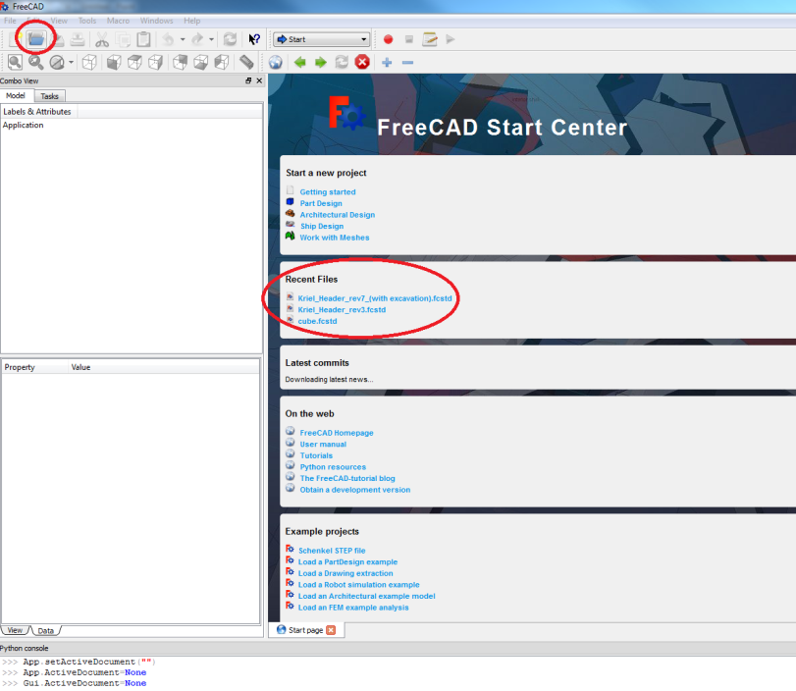
Setting Preferences
Setting Calculix solver directory:
The solver used for FEM analyses in FreeCAD is called “Calculix”. Since FreeCAD is not installed but only extracted, the default location for the solver is not automatically updated but must be manually changed. This is done in the FEM preferences of FreeCAD.
In order to access the FEM preferences of FreeCAD, you must have an active FEM analysis open. So after opening FreeCAD, you are greeted by the “Start Page”.
Either open a FEM analysis by clicking on the “Open File” icon at the top of the screen and navigating to it, or, if you have recently worked on a FEM analysis, select it from the “Recent Files” box on the start page.

Slide 7
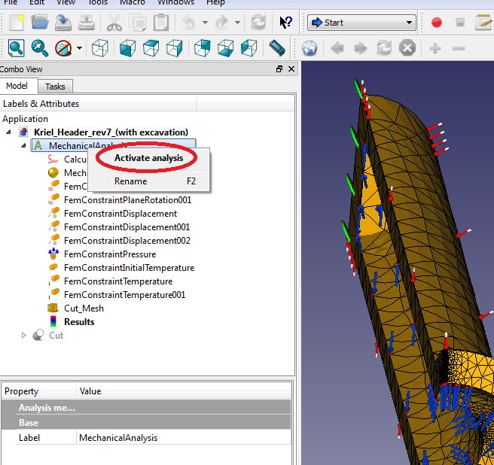
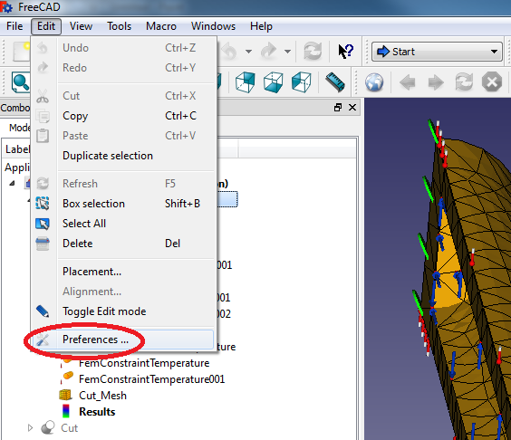
Setting Preferences
Setting Calculix solver directory:
After opening the FEM model, ensure that the analysis is active by right-clicking on the “Mechanical Analysis” label under the “Model” tree view and selecting “Activate Analysis”.
Next, click on the “Edit” menu at the top of the screen and select “Preferences from the dropdown menu.

Slide 8
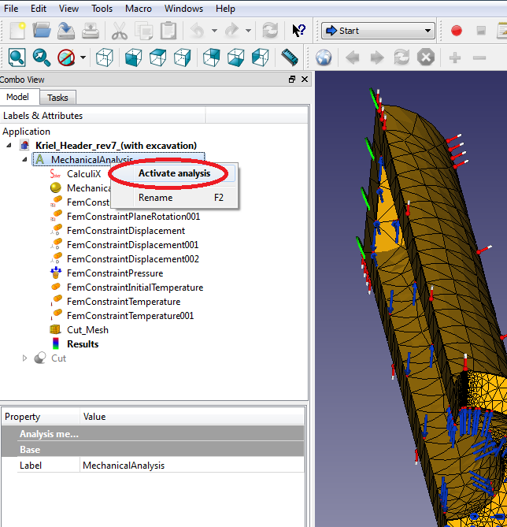
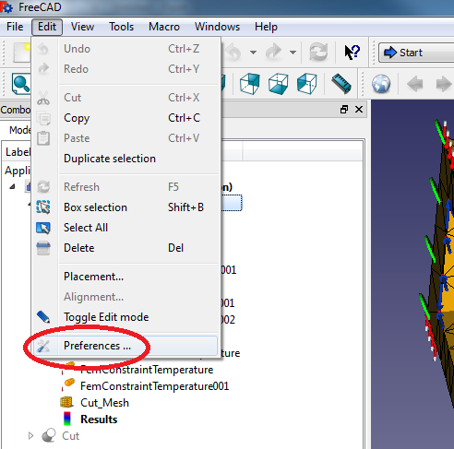
Setting Preferences
Setting Calculix solver directory:
Right-click on the “Mechanical Analysis” label under the “Model” tree view, and select “activate analysis’. Now the analysis should be active.
Next, click on the “Edit” dropdown menu at the top of the screen and select “Preferences”.

Slide 9
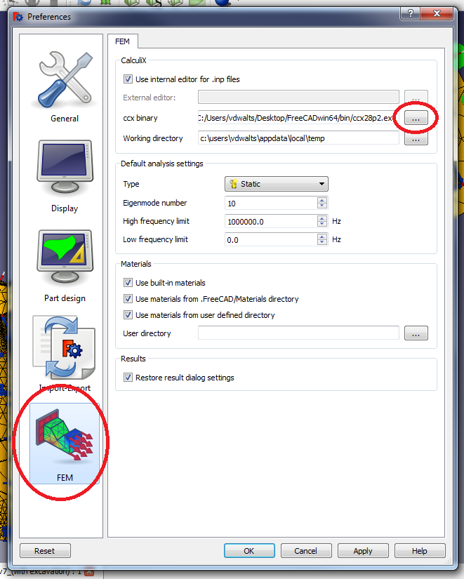
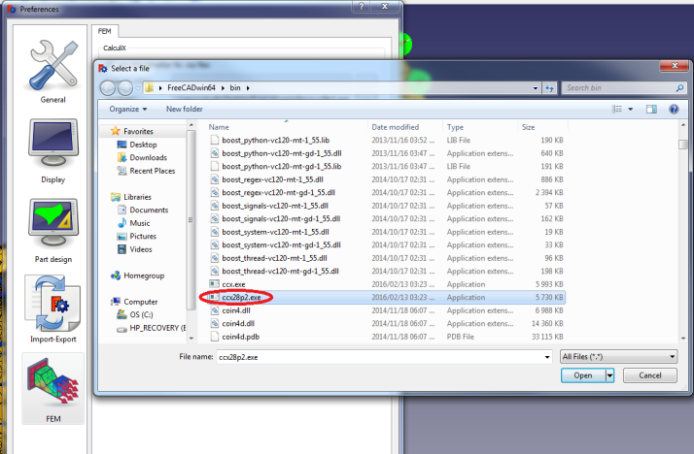
Setting Preferences
Setting Calculix solver directory:
After opening the “Preferences”, click on the “FEM” tab. This will open all the FEM preferences.
Click on the “…” icon next to the “ccx binary” label un der the “CalculiX” heading. This will open windows explorer.
Navigate to the same folder (the “bin” folder) where the “FreeCAD” executable file is located (not the shortcut file, the original .exe file).
Select the newest ccx.exe file located here. In the example it is ccx28p2.exe (which is ccx version 2.8), but if there is a newer version available (e.g. ccx29.exe, ccx210.exe etc. or similar, select that one). Click “Open”
The correct directory will now be shown next to the “ccx binary” label. Close the Preferences dialog by clicking “Apply” and then “OK”.

Slide 10
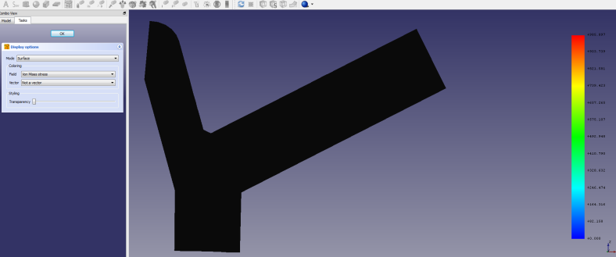
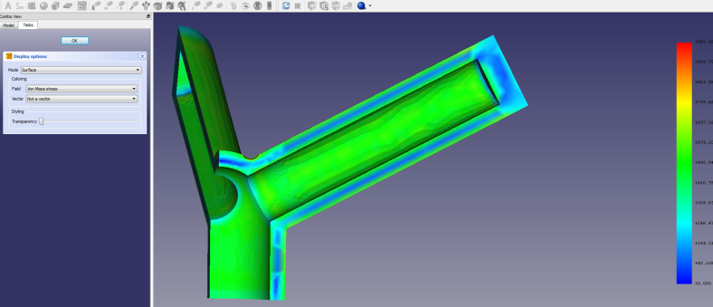
Setting Preferences
Setting backlight color:
When creating a results pipeline and displaying your FEM results, the results will by default seem as if there is a problem with your display driver. Since the results’ colour gradient should be superimposed on the CAD model, the results with only a black silhouette may seem like an error. It is not. It is just because a backlight is not defined yet. The pictures on the right demonstrate the difference between activating and deactivating the backlight color.
NB: This doesn’t influence the display of the normal results , only the display when creating a results pipeline (which uses VTK) .
A model doesn’t need to be open to apply this changes. There will just be fewer icons available in the “Preferences” window (e.g. the “FEM” icon won’t be there, as well as a few other icons.)

Slide 11
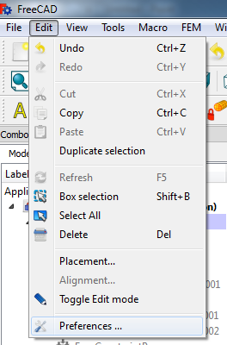
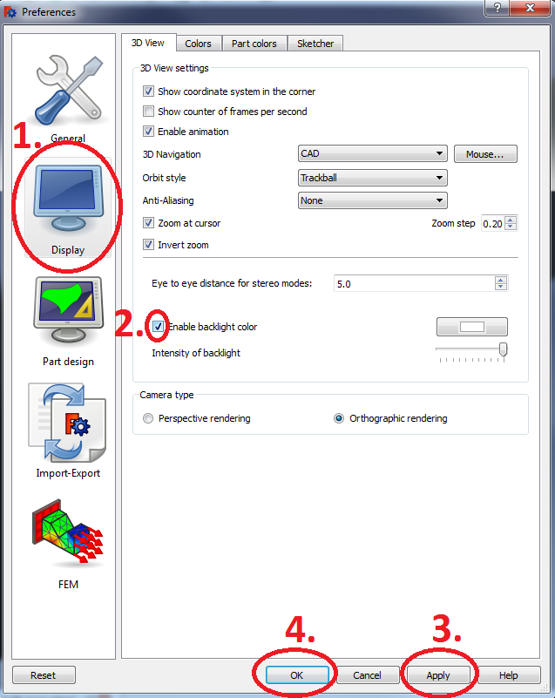
Setting Preferences
Setting backlight color:
At the top menu, go to “Edit” and select “Preferences”.
When the “Preferences” window pops up, click on the “Display” icon on the left and click in the box next to “Enable backlight color”. A tick mark should appear inside the box to indicate that the box is activated. You can later play with the color and intensity settings to suit your needs.
Click on “Apply” to apply the changes.
Click on “OK” to close the “Preferences” window.

Slide 12
Adding Environmental Variable
Adding the Environmental variable for Maximum number of threads:
Almost all computers these days have multicore processors which can each process multiple threads. In order to utilise the maximum potential of our computers when solving FEM analyses with Calculix, we need to incorporate multicore processing.
We are going to add an environmental variable to the Windows system which will fix the maximum number of threads used for system processes. This will allow the Calculix solver to utilise more than just one processor in its solution calculation.

Slide 13
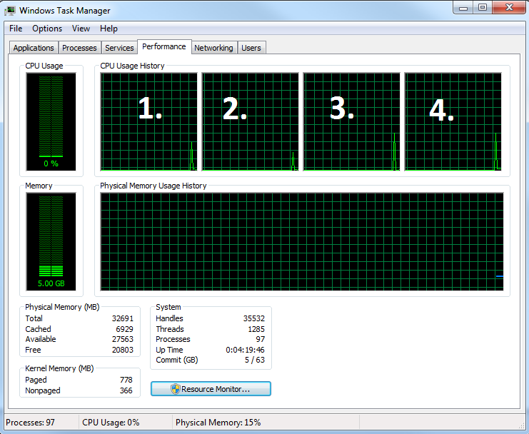
Adding Environmental Variable
Adding the Environmental variable for Maximum number of threads:
The first step will be to determine the amount of processors that your system have. To do this, press ctrl+alt+del simultaneously and click on “start task manager”. Navigate to the “Performance” tab at the top.
You will see the number of cores your computer has by counting the number of boxes under “CPU Usage History”. In the example there is four.
After you’ve counted the number of cores, you can close the “Windows Task Manager” window.

Slide 14
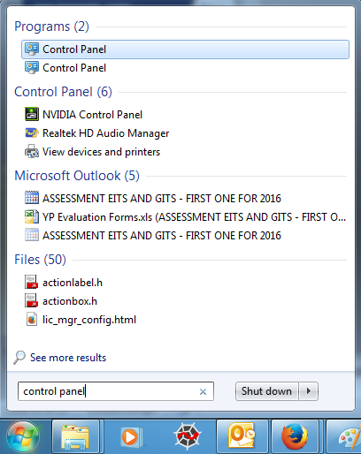
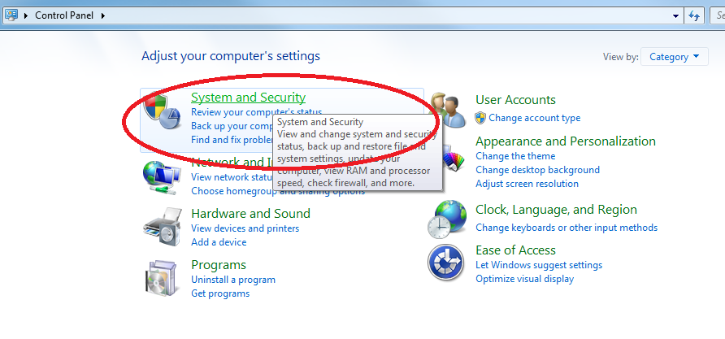
Adding Environmental Variable
Adding the Environmental variable for Maximum number of threads:
First of all, close FreeCAD.
The next step will be to physically add the environmental variable. Open “Control Panel”. If you don’t know where it is located, just click on the start button and type “Control Panel” in the search box at the bottom.
Click on “System and Security”.

Slide 15
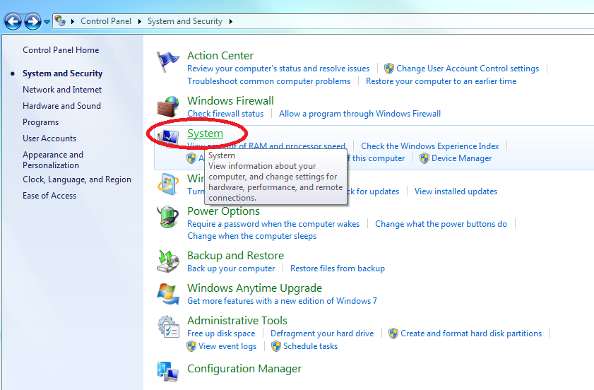
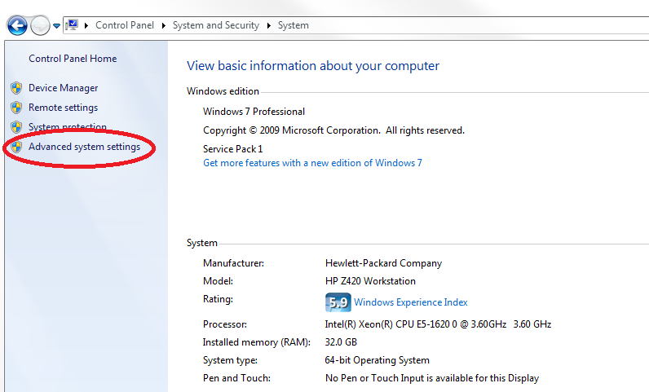
Adding Environmental Variable
Adding the Environmental variable for Maximum number of threads:
Click on “System”.
Click on “Advanced system settings” on the left.

Slide 16
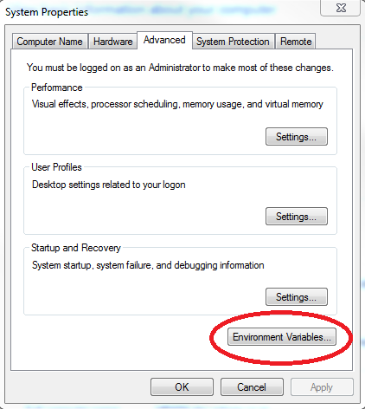
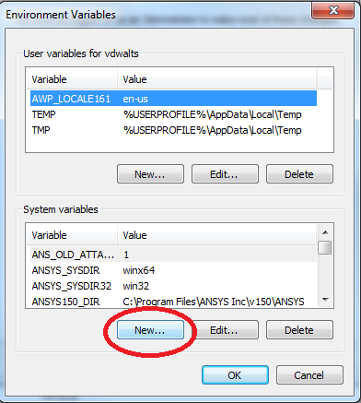
Adding Environmental Variable
Adding the Environmental variable for Maximum number of threads:
Click on “System”.
Click on “Advanced system settings” on the left. A System Properties window should pop up.
Click on “Environmental Variables…” on the bottom right-hand side. Another window opens up.
Under System variables, click “New”.

Slide 17
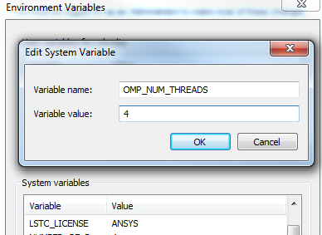
Adding Environmental Variable
Adding the Environmental variable for Maximum number of threads:
Now type in the variable name box: OMP_NUM_THREADS
And type in the variable value the number of cores that you counted earlier.
Click “OK” to close the “Edit System Variable” window.
Click “OK” to close the “Environmental Variables” window.
Click “OK” to close the “System Properties” window.
Close “Control Panel”.

Slide 18

END

